Slide 1
CSM 357
Human-Computer Interaction lecture 6: HCI Paradigms/ Cognitive models
Rose-Mary Owusuaa Mensah Gyening

Slide 2
HCI PARADIGMS

Slide 3
HCI Paradigms
we now build interactive systems that are more usable than those built in the past.
We also believe that there is considerable room for improvement in designing more usable systems in the future.
the great advances in computer technology have increased the power of machines and enhanced the bandwidth of communication between humans and computers.
The impact of technology alone, however, is not sufficient to enhance its usability.
Paradigms for interaction have for the most part been dependent upon technological advances and their creative application to enhance interaction.

Slide 4
HCI Paradigms
In this section, we investigate some of the principal historical advances in interactive
designs.
They do not provide mutually exclusive categories, as particular systems will often incorporate ideas from more than one of the following paradigms

Slide 5
The initial paradigm: Batch processing
Batch processing
Impersonal computing

Slide 6
Batch Processing systems
Batch processing is a method of running high-volume, repetitive data jobs.
The batch method allows users to process data when computing resources are available, and with little or no user interaction.
With batch processing, users collect and store data, and then process the data during an event known as a “batch window.”
This is achieved by placing a list of the commands to start the required jobs into a BATCH FILE that can be executed as if it were a single program:
hence batch processing is most often used in operating systems that have a COMMAND LINE user interface.

Slide 7
Batch Processing systems
Indeed, batch processing was the normal mode of working in the early days of mainframe computers, but modern personal computer applications typically require frequent user interaction, making them unsuitable for batch execution.

Slide 8
Example Paradigm Shifts: Time-sharing
Time-sharing
Interactive computing

Slide 9
Paradigms for interaction: Time sharing
In the 1940s and 1950s, the significant advances in computing consisted of new hardware technologies. Mechanical relays were replaced by vacuum electron tubes. Tubes were replaced by transistors, and transistors by integrated chips, all of which meant that the amount of sheer computing power was increasing by orders of magnitude.
By the 1960s it was becoming apparent that the explosion of growth in computing power would be wasted if there was not an equivalent explosion of ideas about how to channel that power.

Slide 10
Paradigms for interaction: Time sharing
One of the leading advocates of research into human-centered applications of computer technology was J. C. R. Licklider, who became the director of the Information Processing Techniques Office of the US Department of Defense’s Advanced Research Projects Agency (ARPA).
It was Licklider’s goal to finance various research centers across the United States in order to encourage new ideas about how best to apply the burgeoning computing technology.

Slide 11
Paradigms for interaction: Time sharing
One of the major contributions to come out of this new emphasis in research was the concept of time sharing, in which a single computer could support multiple users.
Previously, the human (or more accurately, the programmer) was restricted to batch sessions, in which complete jobs were submitted on punched cards or paper tape to an operator who would then run them individually on the computer

Slide 12
Example Paradigm Shifts: Networking
@#$% !
Networking
???
Community computing

Slide 13
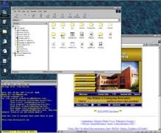
Example Paradigm Shifts: Graphical displays
Move this file here,
and copy this to there.
C…P… filename
dot star… or was
it R…M?
Graphical displays
% foo.bar
ABORT
dumby!!!
Direct manipulation

Slide 14
Example Paradigm Shifts: Microprocessor
Microprocessor
Personal computing

Slide 15
Example Paradigm Shifts: WWW
Probably the most significant recent development in interactive computing is the world wide web, often referred to as just the web, or WWW.
The web is built on top of the internet, and offers an easy to use, predominantly graphical interface to information, hiding the underlying complexities of transmission protocols, addresses and remote access to data.
Global information

Slide 16
Example Paradigm Shifts: WWW
The internet is simply a collection of computers, each linked by any sort of data connection, whether it be slow telephone line and modem or high-bandwidth optical connection

Slide 17
Example Paradigm Shifts: WWW
The world wide web project was conceived in 1989 by Tim Berners-Lee, working at CERN, the European Particle Physics Laboratory at Geneva, as a means to enable the widespread distribution of scientific data generated at CERN and to share information between physicists worldwide.
In 1991 the first text-based web browser was released. This was followed in early 1993 by several graphical web browsers, most significantly Mosaic developed by Marc Andreesen at the National Center for Supercomputer Applications (NCSA) at Champaign, Illinois.
This was the defining moment at which the meteoric growth of the web began, rapidly growing to dominate internet traffic and change the public view of computing

Slide 18
Video Display Units
As early as the mid-1950s researchers were experimenting with the possibility of presenting and manipulating information from a computer in the form of images on a video display unit (VDU).
These display screens could provide a more suitable medium than a paper printout for presenting vast quantities of strategic information for rapid assimilation.
The earliest applications of display screen images were developed in military applications, most notably the Semi-Automatic Ground Environment (SAGE) project of the US Air Force.
It was not until 1962, however, when a young graduate student at the Massachusetts Institute of Technology (MIT), Ivan Sutherland, astonished the established computer science community with his Sketchpad program, that the capabilities of visual images were realized

Slide 19
Ubiquitous Computing
Where does computing happen, and more importantly, where do we as users go to interact with a computer?
Over the past 50 years of interactive computing, we thought of computers as being confined to a box on a desk or in an office or lab.
In the late 1980s, a group of researchers at Xerox PARC, led by Mark Weiser, initiated a research program with the goal of moving human–computer interaction away from the desktop and out into our everyday lives.
Weiser observed:
The most profound technologies are those that disappear. They weave themselves into the fabric of everyday life until they are indistinguishable from it.

Slide 20
Ubiquitous Computing
These words have inspired a new generation of researchers in the area of ubiquitous computing.
Another popular term for this emerging paradigm is pervasive computing, first coined by IBM.
The intention is to create a computing infrastructure that permeates our physical environment so much that we do not notice the computer any longer.
A good analogy for the vision of ubiquitous computing is the electric motor. When the electric motor was first introduced, it was large, loud and very noticeable. Today, the average household contains so many electric motors that we hardly ever notice them anymore. Their utility led to ubiquity and, hence, invisibility.

Slide 21
Ubiquitous Computing
How long in the future will it be before we no longer notice the interactive computer?
To some extent, this is already happening, since many everyday items, such as watches, microwaves or automobiles, contain many microprocessors that we don’t directly notice.
But, to a large extent, the vision of Weiser, in which the computer is hardly ever noticed, is a long way off.

Slide 22
Cognitive models
Cognitive models depict some representation of users as they interact with an interface; that is, they model some aspect of the user’s understanding, knowledge, intentions or processing.
The level of representation differs from technique to technique – from models of high-level goals and the results of problem-solving activities, to descriptions of motor-level activity, such as keystrokes and mouse clicks.

Slide 23
Cognitive models
A cognitive model is a computer program that behaves like a human being.
It may emulate the perceptual, cognitive and/or motor processes people go through to complete a task.
  It may take the same amount of time that people take to perform a task.
  It may make the same type of errors people make.
  It may take the same amount of time and require the same type of experience to learn to perform a task

Slide 24
Cognitive models: Predicting Human Behaviour on Proposed Interactive Systems
The overall motivation for HCI cognitive modelling efforts is to provide engineering models of human performance.
In the ideal, such models produce a priori quantitative predictions of performance at an earlier stage in the development process than prototyping and user testing.
That is, they predict execution time, learning time, errors, and identify those parts of an interface that lead to these predictions, thereby focusing the designer on what to fix

Slide 25
Uses of cognitive models
A cognitive model can substitute for a human user to predict how users will perform on a system before it is implemented or even prototyped.
A system can generate a cognitive model of the user currently interacting with the system in order to modify the interaction to better serve that user.
Finally, cognitive models can substitute directly for people so groups of individuals can be simulated in situations that require many participants, e.g., for training or entertainment.

Slide 26
Cognitive models in HCI
cognitive models are divided into the following categories:
  Hierarchical models represent a user’s task and goal structure.
  Linguistic models represent the user–system grammar.
  Physical and device models represent human motor skills.
The first category deals directly with the issue of formulation of goals and tasks. The second deals with the grammar of the articulation translation and how it is understood by the user. The third category again deals with articulation, but at the human motor level instead of at a higher level of human understanding.

Slide 27
Hierarchical models represent a user’s task and goal structure
Many hierarchical models make use of a model of mental processing in which the user achieves goals by solving subgoals in a divide-and-conquer fashion.
We will consider two models, GOMS and CCT (Cognitive complexity theory)

Slide 28
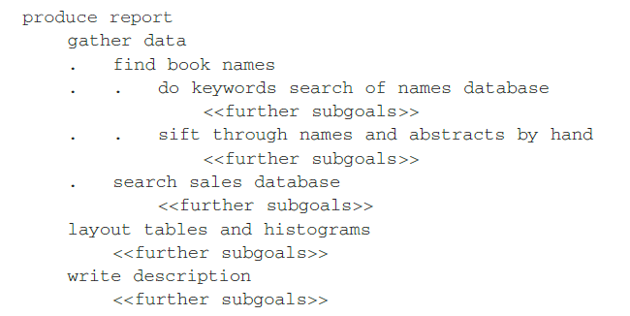
Hierarchical models represent a user’s task and goal structure
Imagine we want to produce a report on sales of introductory HCI textbooks.
To achieve this goal we divide it into several subgoals, say gathering the data together, producing the tables and histograms, and writing the descriptive material.
Concentrating on the data gathering, we decide to split this into further subgoals: find the names of all introductory HCI textbooks and then search the book sales database for these books.
The example can be laid out to expose this structure:

Slide 29
Hierarchical models represent a user’s task and goal structure
Similarly, each of the other subgoals is divided up into further subgoals, until some level of detail is found at which we decide to stop. We thus end up with a hierarchy of goals and subgoals.

Slide 30
GOMS: HCI
The original GOMS model has served as the basis for much of the cognitive modeling research in HCI.
It was good for describing how experts perform routine tasks.
GOMS is a modeling technique (more specifically, a family of modeling techniques) that analyzes the user complexity of interactive systems. It is used by software designers to model user behavior.

Slide 31
GOMS Model
The GOMS model developed by Card, Moran and Newell is an acronym for Goals, Operators, Methods and Selection
A GOMS description consists of these four elements:
  Goals,
  Operators,
  Methods and
  Selection
  GOMS is a widely used method by usability specialists and computer system designers because it produces quantitative and qualitative predictions of how people will use a proposed system

Slide 32
GOMS: GOALS
Goals
These are the user’s goals, describing what the user wants to achieve.
Further, in GOMS, the goals are taken to represent a ‘memory point’ for the user, from which he can evaluate what should be done and to which he may return should any errors occur.
An example of a Goal might be:-
  GOAL: Copy text from file

Slide 33
GOMS: Operations
These are the lowest level of analysis.
They are the basic actions that the user must perform in order to use the system.
They may affect the system (for example, press the ‘X’ key) or only the user’s mental state (for example, read the dialog box)
another example of an Operation might be:-
Move mouse to Edit Menu

Slide 34
GOMS: Methods
Methods
There are typically several ways in which a goal can be split into subgoals.
For instance, in a certain window manager, a currently selected window can be closed either by clicking on the close icon or by hitting a specific function key.
In GOMS, these two goal decompositions are referred to as methods, so we have the ICON-METHOD and the FUNCTIONKEY-METHOD:

Slide 35
GOMS: Methods/Select
GOAL: CLOSE-WINDOW
. [select GOAL: USE-ICON-METHOD
. . MOVE-MOUSE-TO-WINDOW-HEADER
. . CLICK-ON-THE-CLOSE-ICON
GOAL: USE-FUNCTIONKEY-METHOD
. . PRESS ALT+F4]

Slide 36
GOMS: Selection
From the above snippet, we see the use of the word select where the choice of methods arises.
GOMS does not leave this as a random choice, but attempts to predict which methods will be used.
This typically depends both on the particular user and on the state of the system and details about the goals.
For instance, a user, Sam, never uses the FUNCTIONKEY-METHOD, except the mouse or touch pad is not working.

Slide 37
GOMS: Selection
GOMS captures this in a selection rule for Sam:
  User Sam:
  Rule 1: Use the ICON-METHOD unless another rule applies.
  Rule 2: If the mouse or touch pad is ‘not working’ use the FUNCTIONKEY-METHOD.
Another Example of Selection rule
  Rule1: Use Mouse and Edit menu if hand is currently on mouse.
  Rule 2: Use function key if the hands are currently homed on the keyboard.

Slide 38
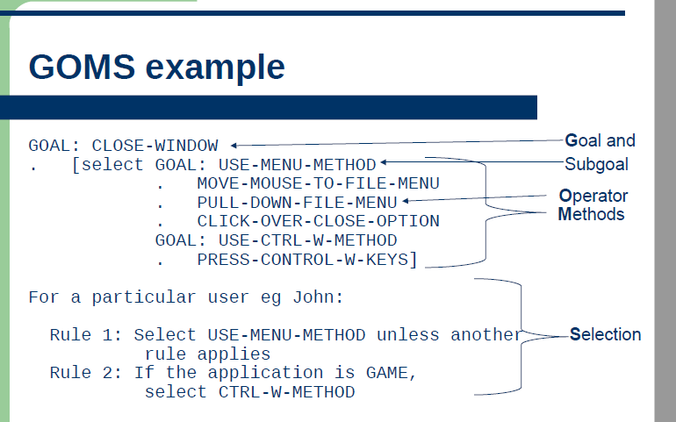

Slide 39
Exercise
Create a GOMS description of the tasks below
  Open a file
  Delete a file
  Copy a file from “documents” to desktop

Slide 40
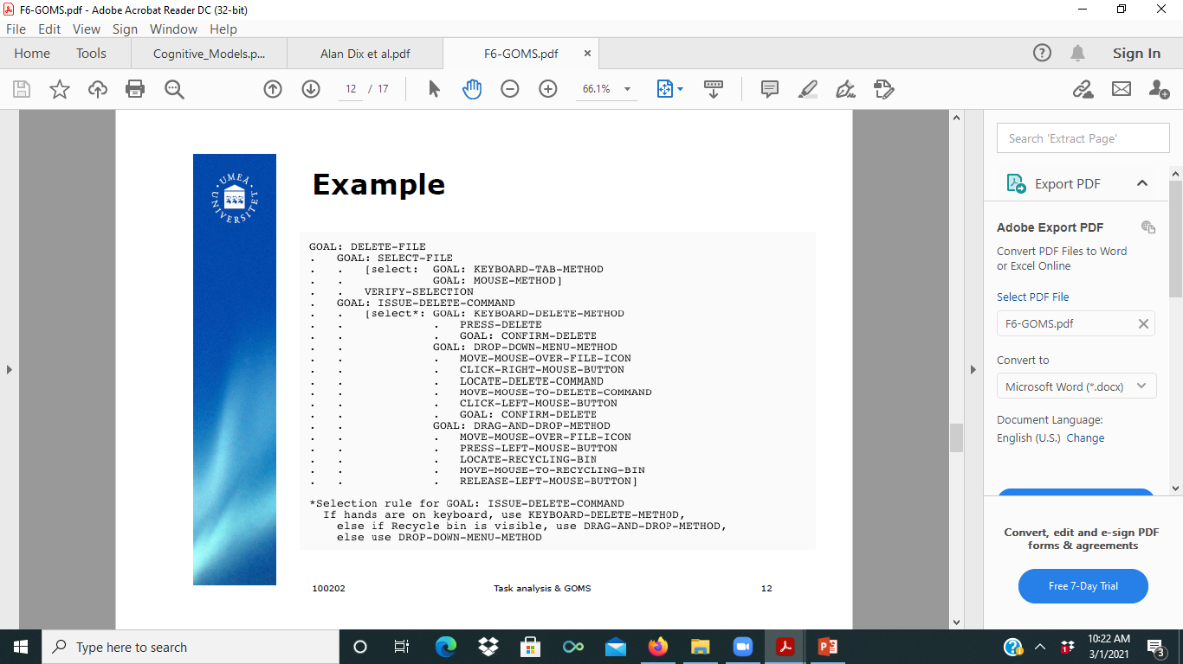

Slide 41
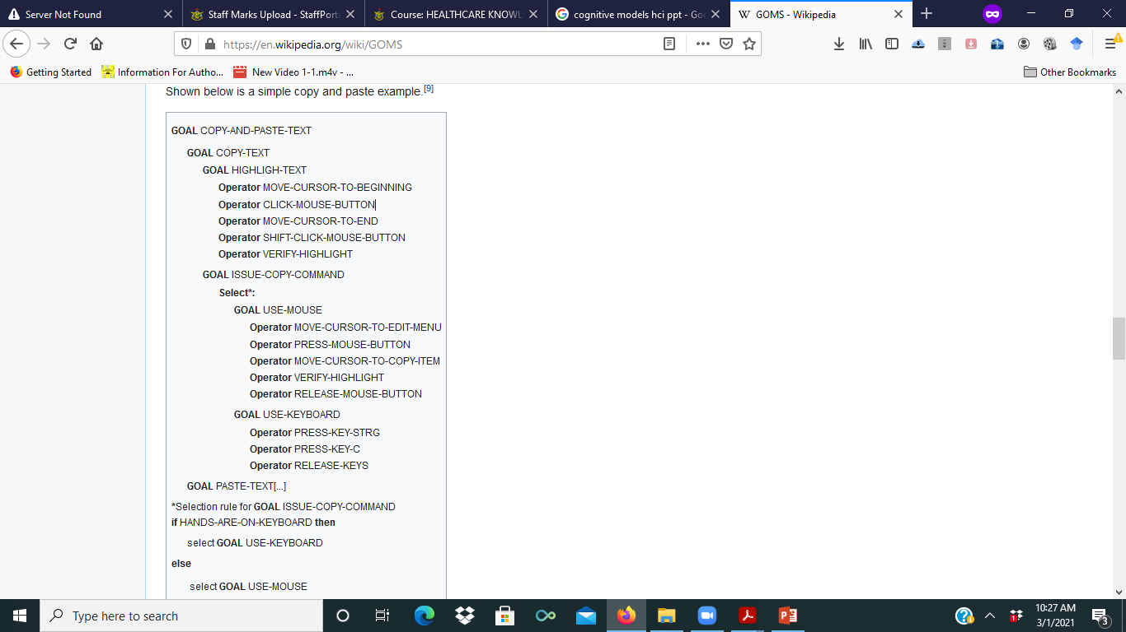

Slide 42
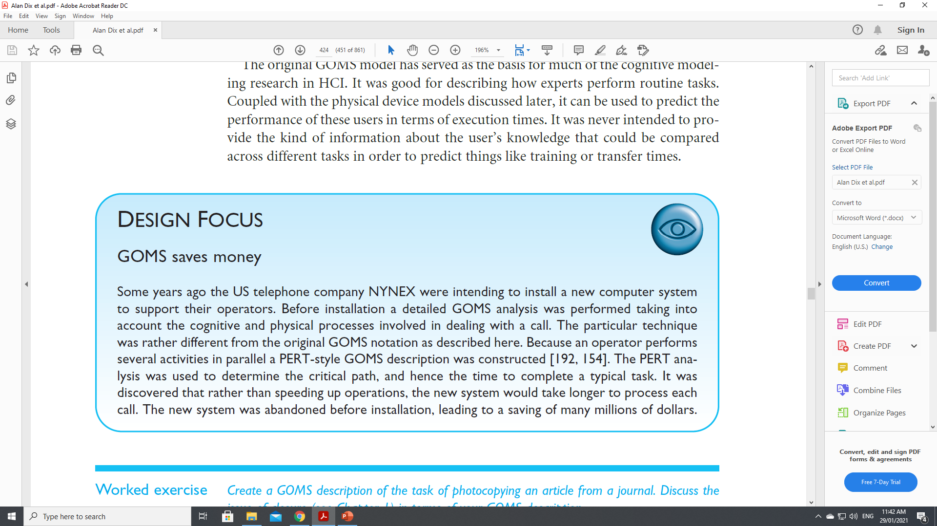

Slide 43
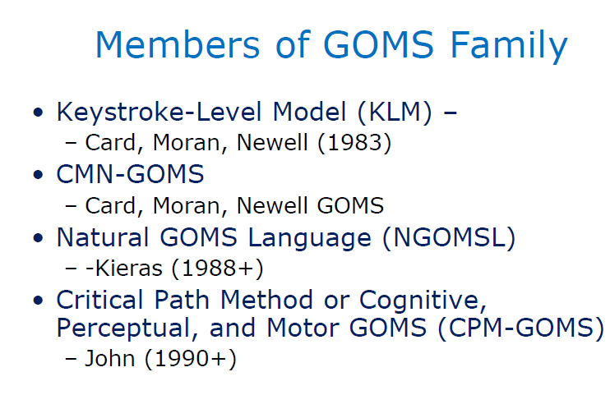

Slide 44
Cognitive complexity theory
Cognitive complexity theory, introduced by Kieras and Polson, begins with the basic premises of goal decomposition from GOMS and enriches the model to provide more predictive power.
CCT has two parallel descriptions: one of the user’s goals and the other of the computer system(called the device in CCT).
The description of the user’s goals is based on a GOMS-like goal hierarchy, but is expressed primarily using production rules.
For the system grammar, CCT uses generalized transition networks, a form of state transition network.

Slide 45
Cognitive complexity theory: Production rules
The production rules are a sequence of rules:
if condition then action
where condition is a statement about the contents of working memory. If the condition is true then the production rule is said to fire.
An action may consist of one or more elementary actions, which may be either changes to the working memory, or external actions such as keystrokes.
The production rule ‘program’ is written in a LISP-like language.

Slide 46
Cognitive complexity theory: Production rules
As an example, we consider an editing task using the UNIX vi text editor. The task is to insert a space where one has been missed out in the text, for instance if we noticed that in the above paragraph we had written ‘cognitivecomplexity theory’.
This is a reasonably frequent typing error and so we assume that we have developed good procedures to perform the task. We consider a fragment of the associated CCT production rules.

Slide 47
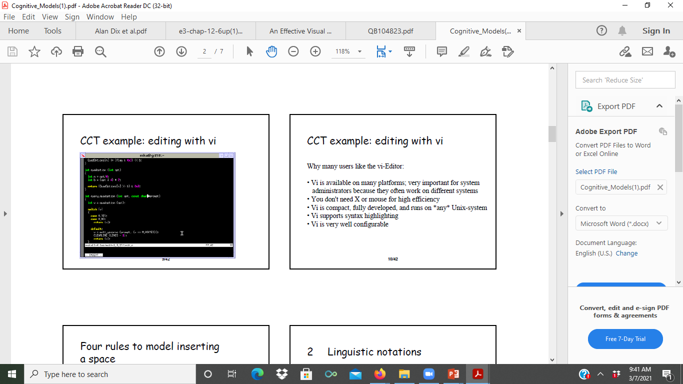

Slide 48
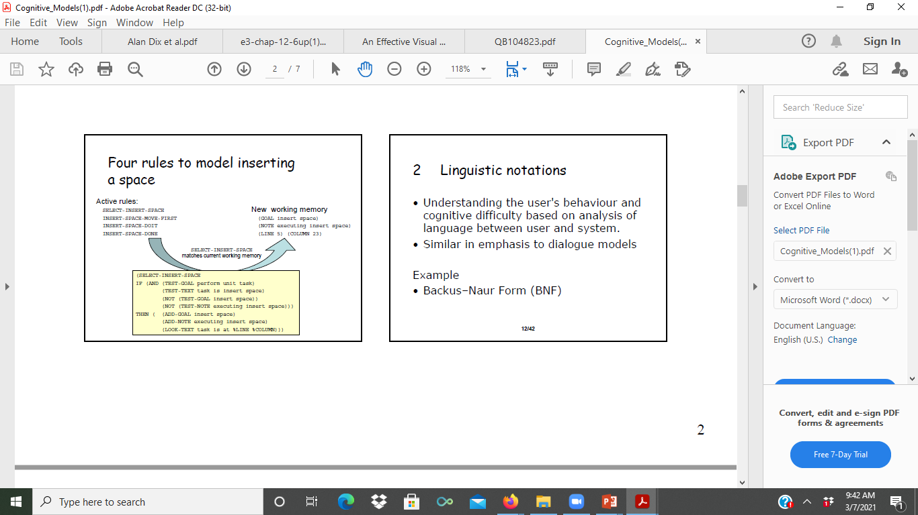

Slide 49
  Linguistic models represent the user–system grammar: Backus-Naur Form (BNF)
The user’s interaction with a computer is often viewed in terms of a language, so it is not surprising that several modeling formalisms have developed centered around this concept
Indeed, BNF grammars are frequently used to specify dialogs.
BNF uses a range of symbols and expressions to create production rules. A simple BNF production rule might look like this:
<digit> ::= 0|1|2|3|4|5|6|7|8|9
This would be interpreted as: a digit can be defined as 0, 1, 2, 3, 4, 5, 6, 7, 8, or 9

Slide 50
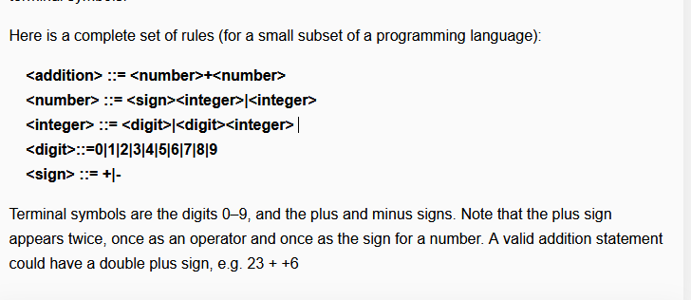

Slide 51
Keystroke-Level Model (KLM)
The Keystroke-Level Model (KLM), proposed by Card, Moran, & Newell (1983), predicts task execution time from a specified design and specific task scenario.
Basically, you list the sequence of keystroke-level actions the user must perform to accomplish a task, and then add up the times required by the actions.
The actions are termed keystroke level if they are at the level of actions like pressing keys, moving the mouse, pressing buttons, and so forth, as opposed to actions like "log onto system" which is much more abstract.
There is a standard set of operators for use in the KLM, whose execution times have been estimated from experimental data.

Slide 52
  Keystroke-Level Model (KLM)
The model decomposes the execution phase into five different physical motor operators, a mental operator and a system response operator:
K Keystroking, actually striking keys, including shifts and other modifier keys.
B Pressing a mouse button.
P Pointing, moving the mouse (or similar device) at a target.
H Homing, switching the hand between mouse and keyboard.
D Drawing lines using the mouse.
M Mentally preparing for a physical action.
R System response (which may be ignored if the user does not have to wait for it)
Physical motor operators
System response operator
Mental operator

Slide 53
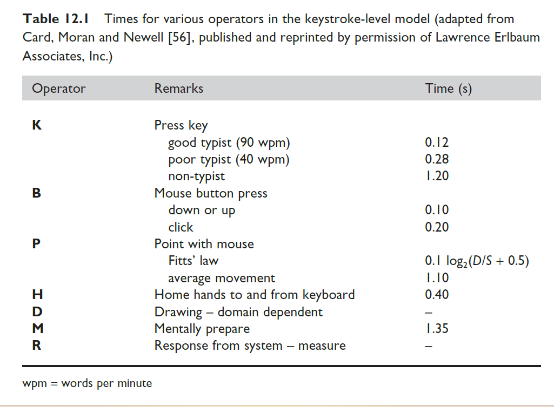

Slide 54
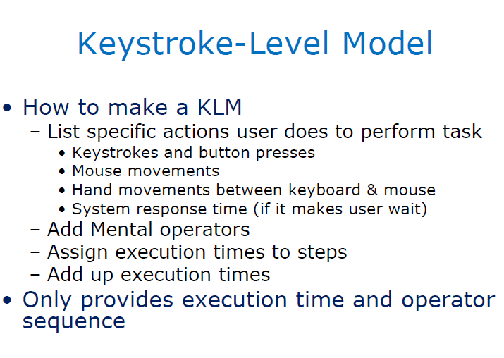

Slide 55
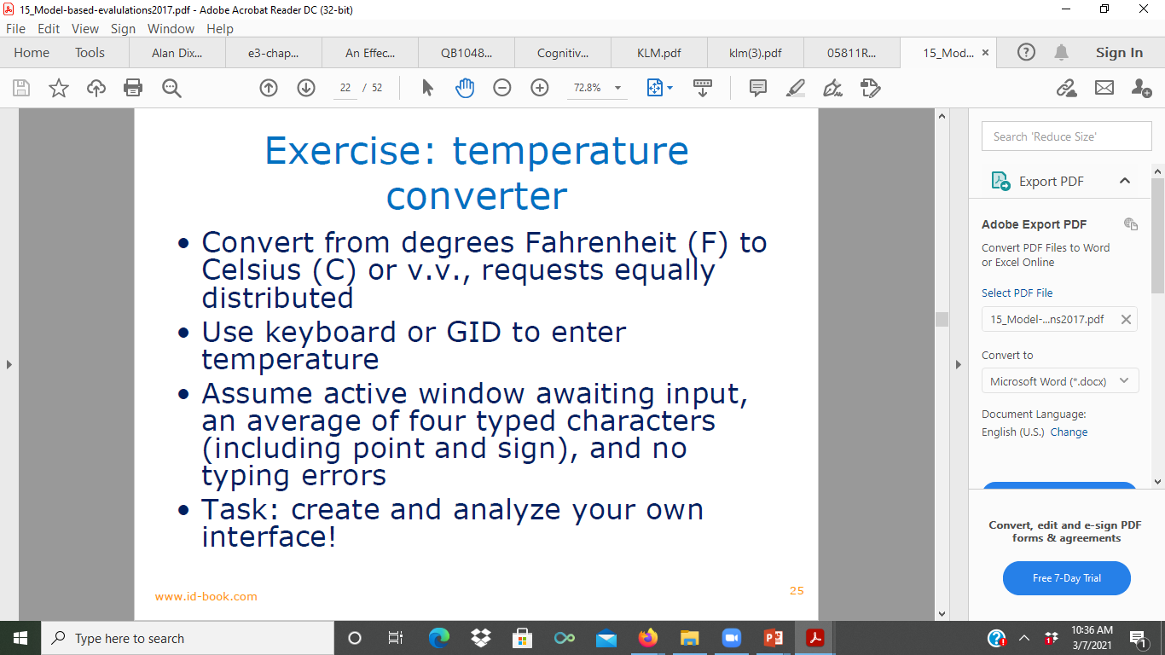

Slide 56
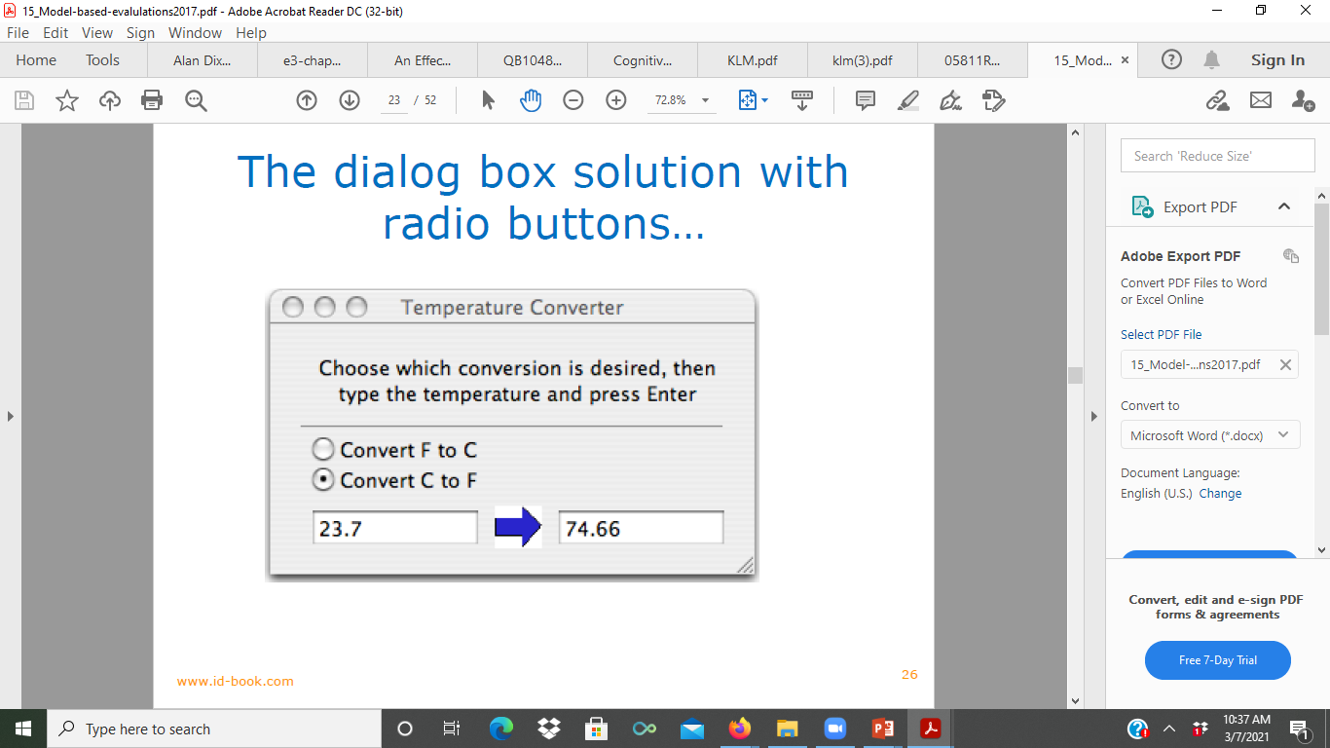

Slide 57
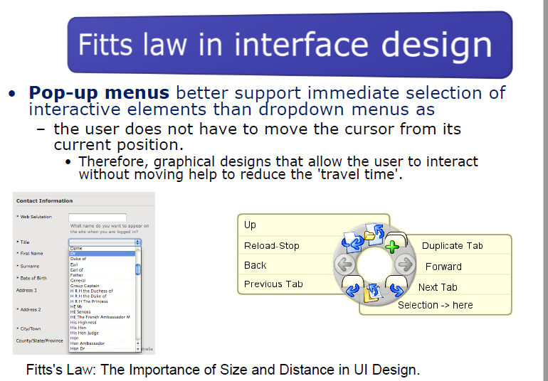

Slide 58
THANK YOU

